Slide 1
Analysis of Transportation Services for Individuals with Intellectual and Developmental Disabilities
Rob Gregg
Jay Goodwill
Ann Joslin
November 28, 2017 l Tallahassee, Florida

Slide 2





TD Services Study
October 5th
Task Force Meet Progress Report and Research
November 8th APD Response comments
September 15th
Progress Report.
November 28th
Task Force.
December 15th
APD Submittal
August 22nd
Contract initiated
1
2
3
4
5
6
7
8
9
10
11
12
13
14
15
16
August 2nd
Task Force
September 5th
Statement of Work Final
September 20th
Task Force Cancelled IRMA
October 6th – 30th
Recommendation
Concepts
October 30th
Final Draft Submittal
November 15th
Resubmit Final Draft
December 6th Update and Submit Final Report.

Slide 3
SB 2502 Proviso Language Issues
Examine the state’s transportation disadvantaged services, how such services are provided in urban and non-urbanized areas and how to assist in the development and use of different provider models
The use of regional fare payment systems;
The improvement of transportation disadvantaged services in both urban and non-urbanized areas;
The use of intercity and inter-county bus transportation; and
The use of private providers or transportation network companies.
Routing improvement to minimize passenger transfers or wait times;
The ability to provide transportation disadvantaged services between specific origins and destinations selected by the individual user at a time that is agreed upon by the user and the provider of the service; and
The provision of transportation disadvantaged services to individual users to allow them to access health care, places of employment, education, and other life-sustaining activities in a cost-effective and efficient manner, while reducing fragmentation and duplication of services.
Examine use and impact of regional fare payment systems and intercity/inter-county bus transportation

Slide 4
Study Approach
System Models
Technology
Data and Geographies
Service Types
Funding Programs
Proviso Issues
Recommendations
Understanding the Issues
Assessing Operating Environments
Exploring Innovative Approached
Understanding IDD Market
Developing Holistic Recommendation
Menu of Recommendations
Innovation
Assess
Issues
Environment
Research
Best Practices
Innovative Examples
Opportunities
Alternatives
Recommendations

Slide 5
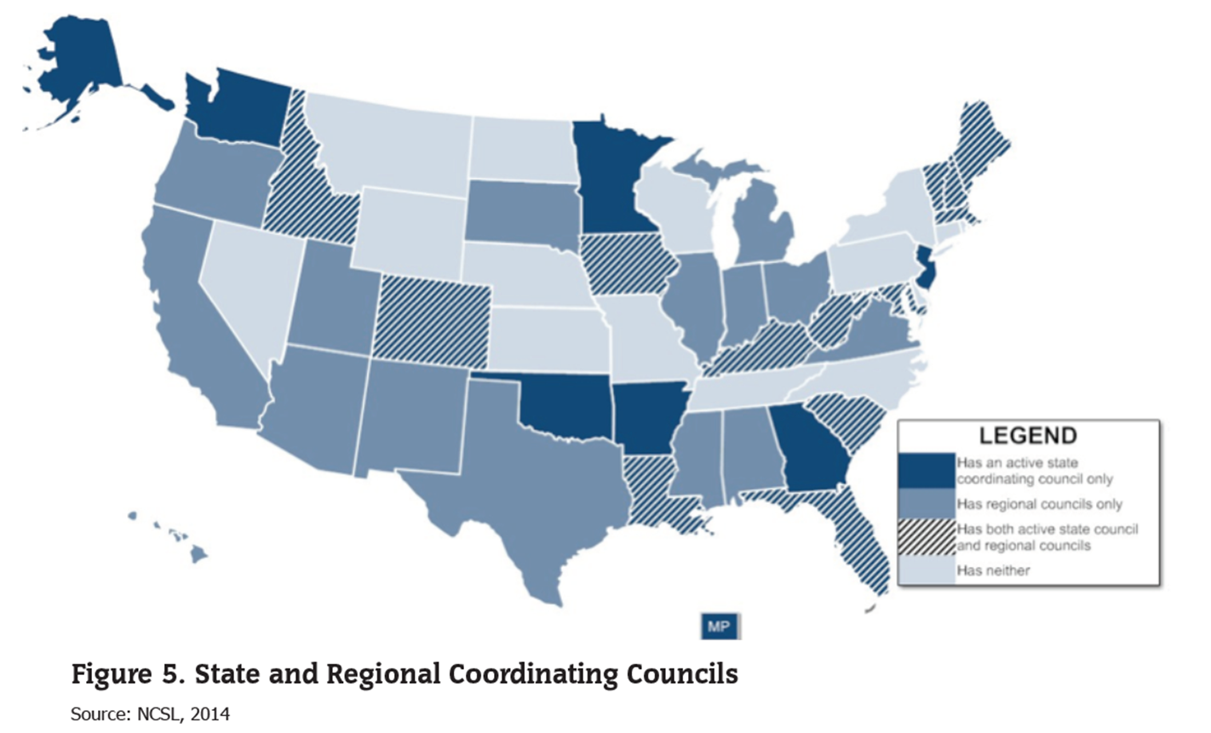
Assessments
Coordinated System National Model
TD / APD Data
Urban vs. Rural
Fare System Analysis
Inter City / County Service
Private Providers / TNC
Service Level / Operational Variables
Technology
IDD Customer Sensitivity / Training

Slide 6
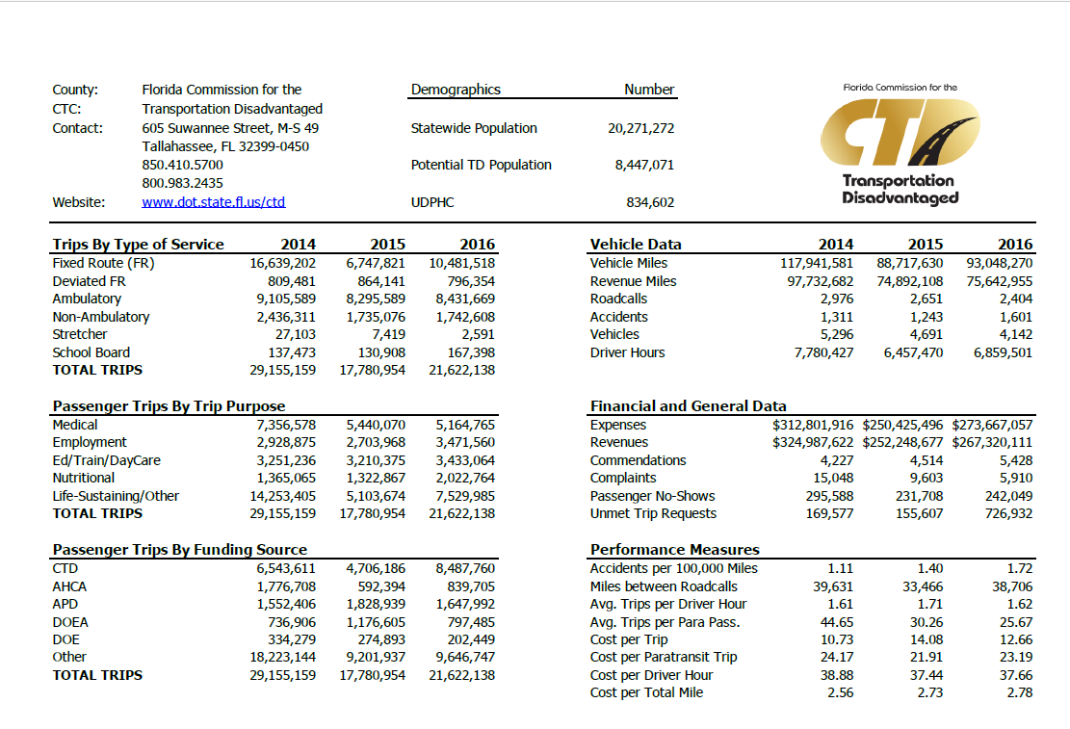
Coordinated System Stats
0.03%
7.62%

Slide 7
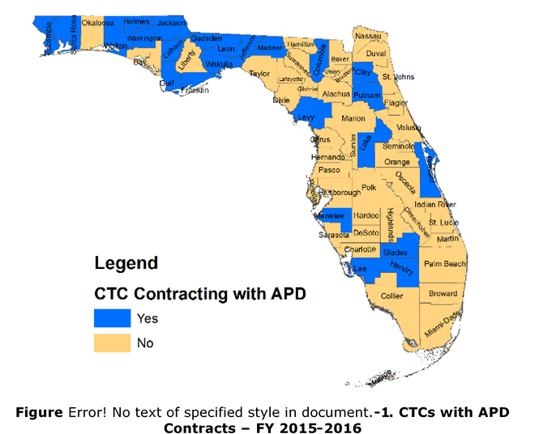
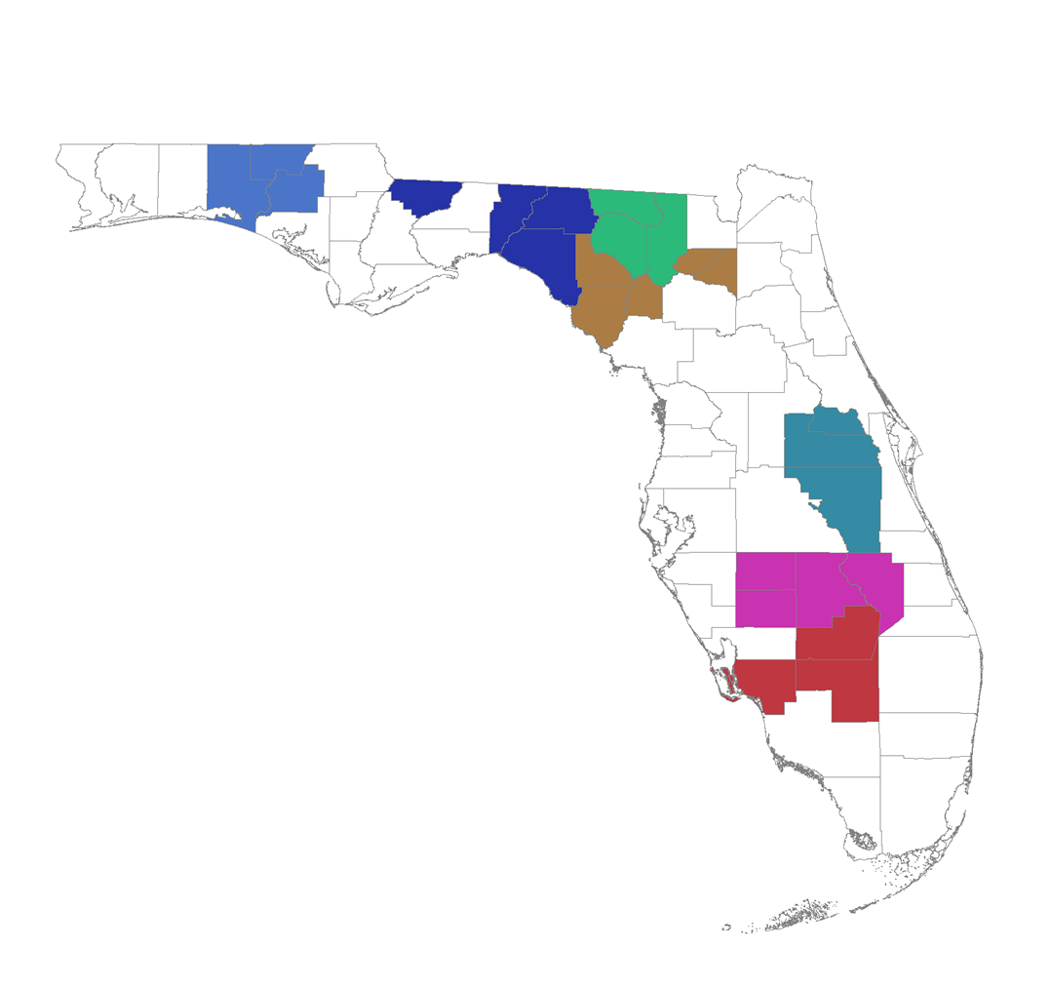
Coordinated System Perspective:
67 Counties
7 Multi County CTCs
31 Urban Transit Systems
Federal Urban / Rural Funds

Slide 8

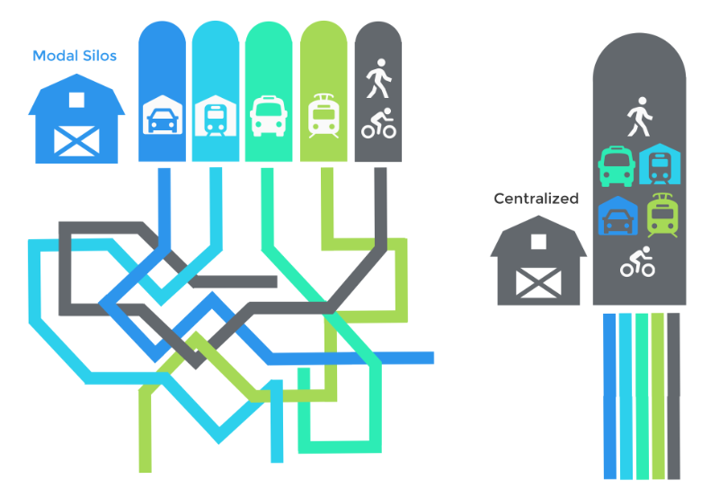

Mobility Management
Coordination
Modes
Programs
Health Care
Human Services
Local Agencies
Regional Perspective
Customer Care
Sensitivity
Travel Training
Travel Planning

Slide 9
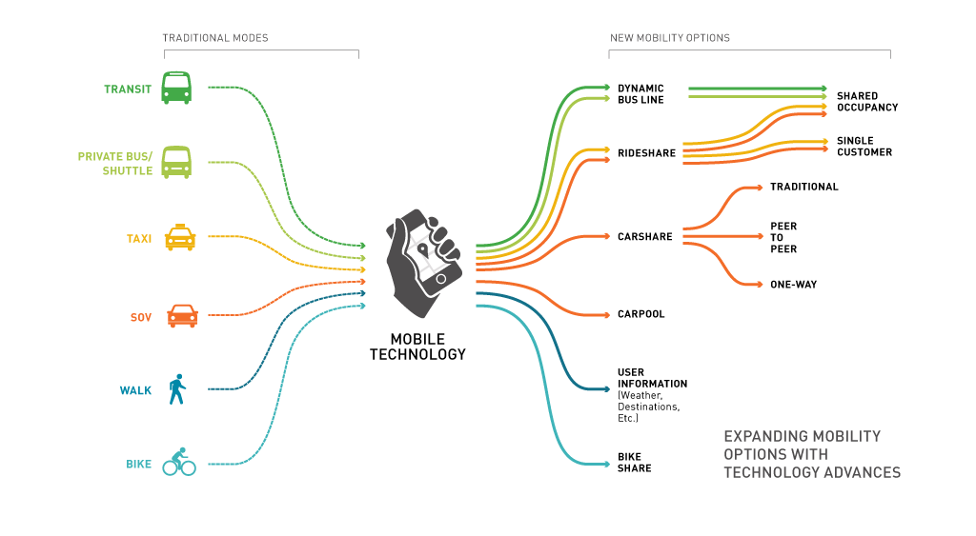

Mobility Options / Mobile Influence
About three-quarters of U.S. adults (77%) say they own a smartphone, up from 35% in 2011
Growing shares of Americans – especially those who are lower-income – rely on smartphones to access the internet

Slide 10

Regional Fare Systems
Where?
Why?
Local Government Policy
Fare Payment Options for IDD
Service Type
Technology

Slide 11
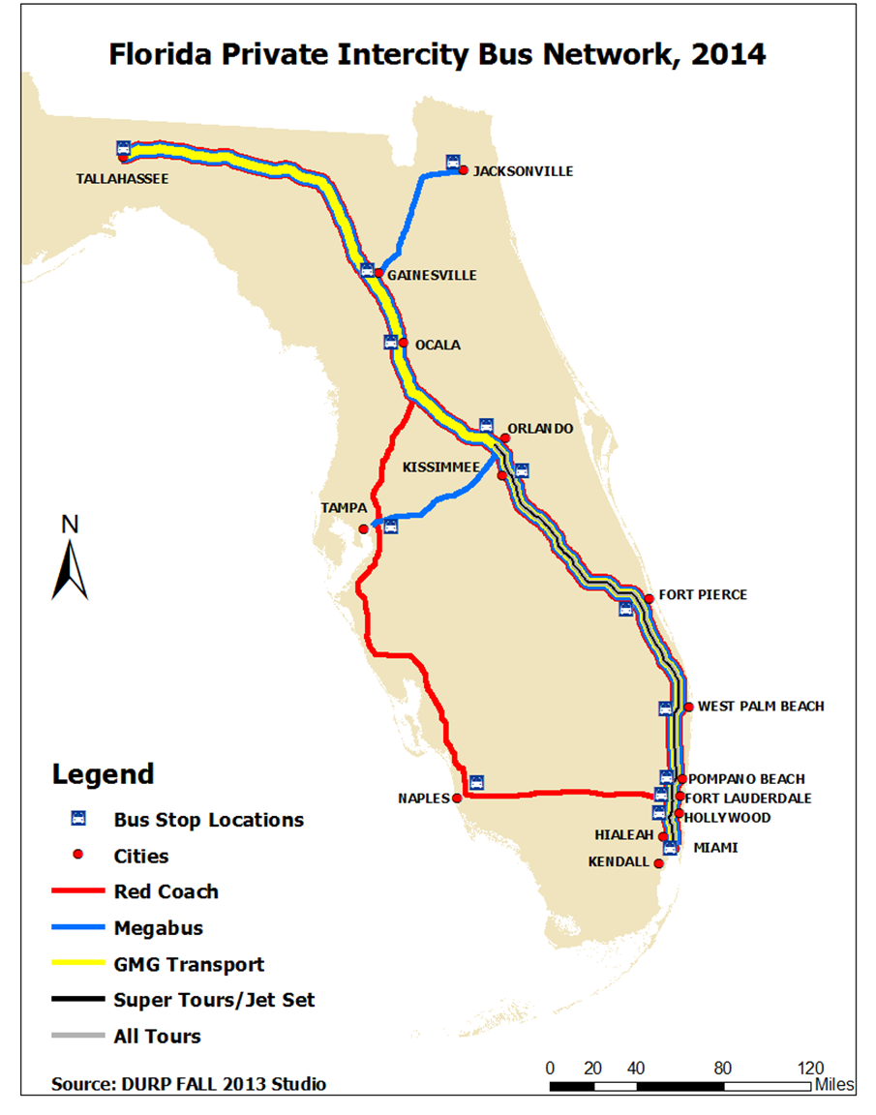
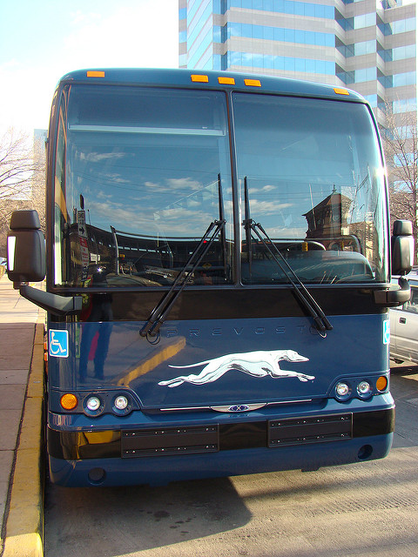
Inter-City Service
Limited Corridors
Private Sector
FTA 5311(f) – Greyhound for Rural Area Access
ADA
Schedule / Routing / Travel Time
Orlando – Titusville – Melbourne – Fort Pierce – Miami
Jacksonville – St. Augustine – Ormond Beach - Port St. Lucie – Miami
Tampa – Lakeland – Avon Park – Winter Haven – Belle – Miami
The new routes are funded through FDOT’s Federal Transit Administration 5311(f) program, which is designed to provide viable transportation options for residents in rural communities.

Slide 12
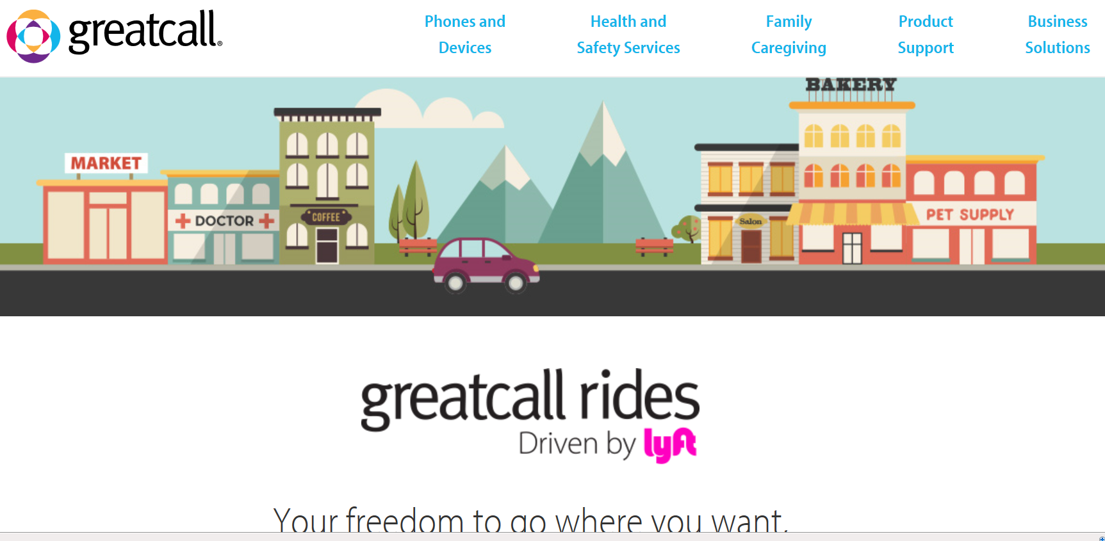
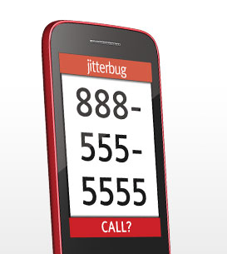

Uber/LYFT Initiatives
Transportation network companies (TNCs) or “ride sourcing,” use smartphone applications to connect drivers with passengers.
LYFT / Great Calls / Jitterbug
Lyft partnering with senior housing operators to offer ride-hailing services that don’t require a smartphone or credit card information. charges are added to residents’ monthly bills. Lyft also is testing a service that lets seniors request a ride through their Jitterbug cell phones.
UberASSIST / uberWAV
Uber offers uberASSIST. This service uses drivers who are trained to help riders get into and out of the vehicle and can accommodate folding wheelchairs,
Uber has also been working to develop partnerships with local senior advocates, in many cities, programs are being tested in which seniors can get discounted — or even free — rides due to city support

Slide 13
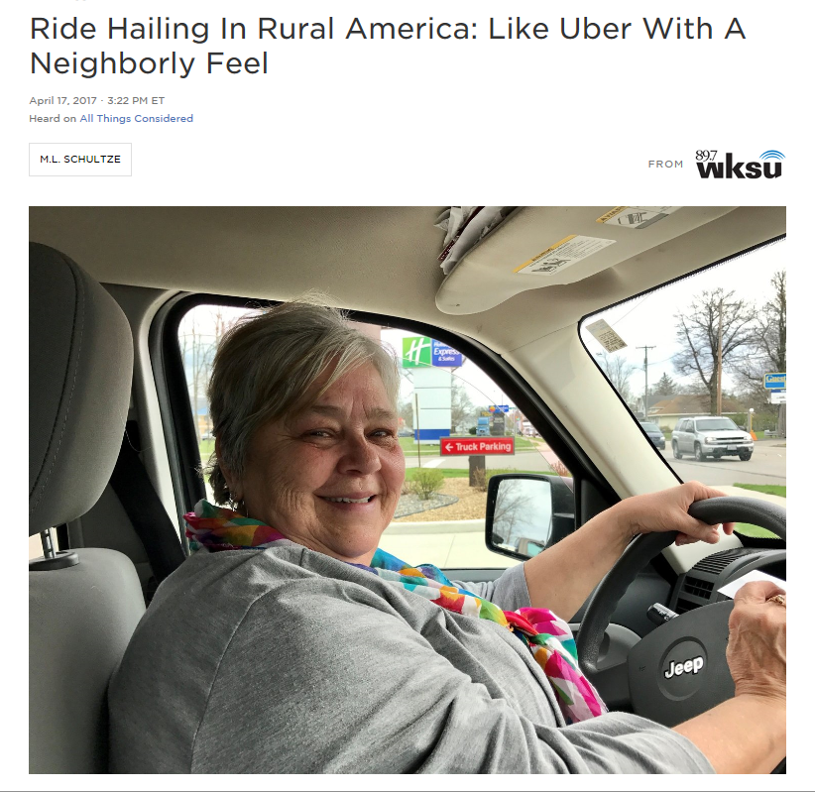
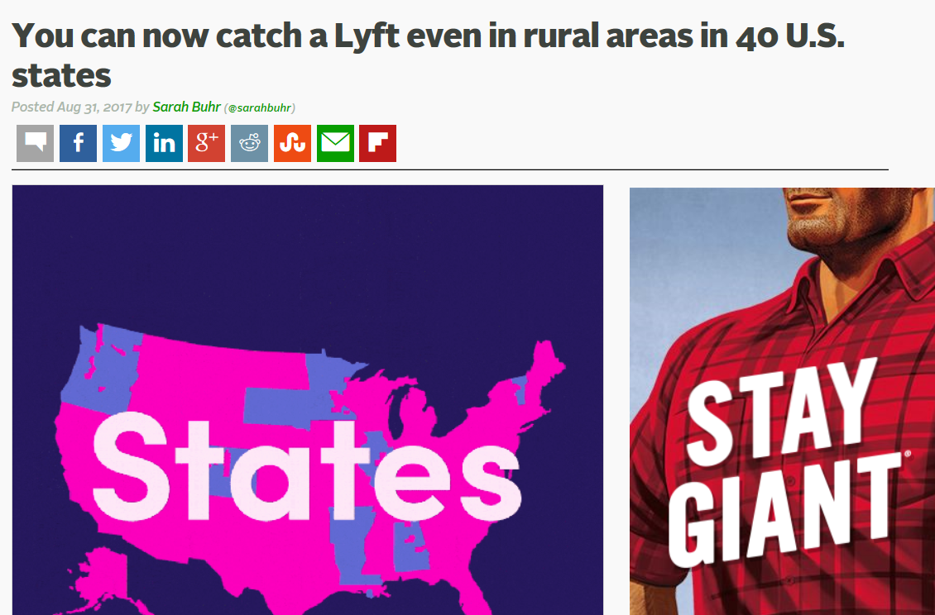

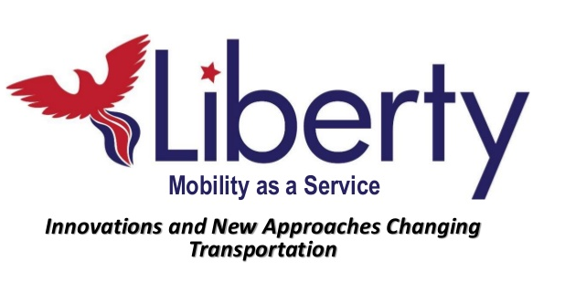
Rural TNC Emerging

Slide 14
The Commission for the Transportation Disadvantaged; purpose and responsibilities.—The purpose of the commission is to accomplish the coordination of transportation services provided to the transportation disadvantaged. The goal of this coordination is to assure the cost-effective provision of transportation by qualified community transportation coordinators or transportation operators for the transportation disadvantaged without any bias or presumption in favor of multi-operator systems or not-for-profit transportation operators over single operator systems or for-profit transportation operators.
Proviso Language
427 F.S. Language
The provision of transportation disadvantaged services to individual users to allow them to access health care, places of employment, education, and other life-sustaining activities in a cost-effective and efficient manner, while reducing fragmentation and duplication of services.
427 F.S. Language
“Transportation disadvantaged” means those persons who because of physical
or mental disability, income status, or age are unable to transport themselves or
to purchase transportation and are, therefore, dependent upon others to obtain
access to health care, employment, education, shopping, social activities, or other
life-sustaining activities, or children who are handicapped or high-risk or at-risk as
defined in s. 411.202.

Slide 15

Recommendations

Slide 16
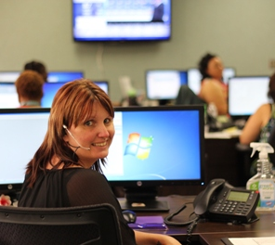

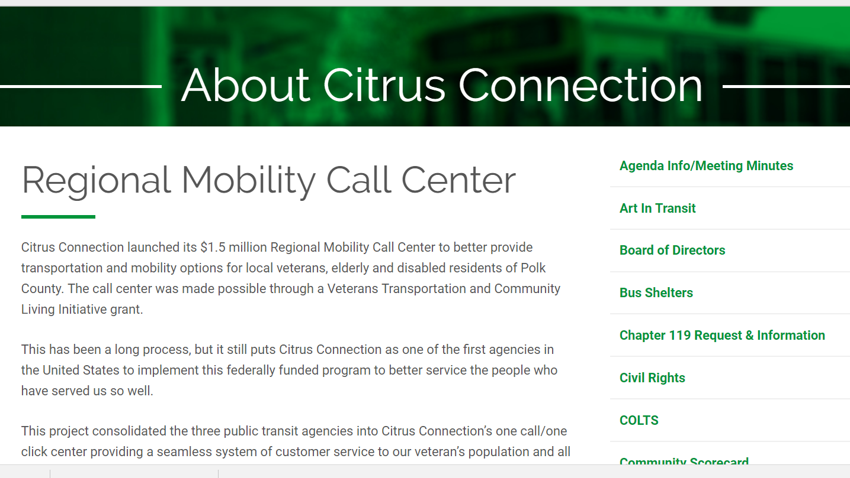
Recommendation #1 Regional Single Point Mobility Information Centers (MICs)
Emphasis on Regional Perspective
Build upon existing models
Sensitivity Trained Customer Oriented Personnel
Affords Opportunities for Private Sector Coordination

Slide 17
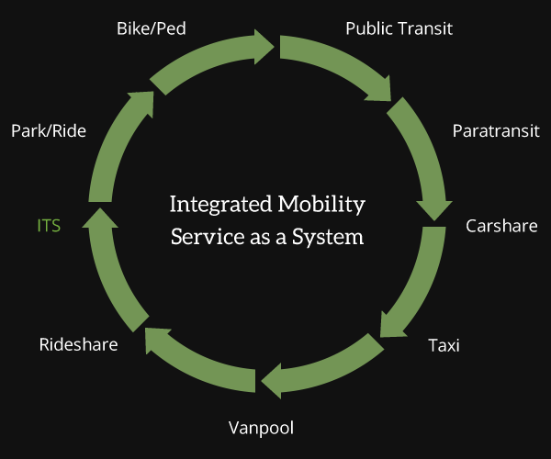

Recommendation #2 Comprehensive Mobility Management Services Program
Incubates Mobility Management Programming
Supports Development of Internal Coordination of Service for Customer Needs
Supports External Coordination of Services for Customer Needs
Promotes Development of New Service Models and Opportunities for TNCs
Opportunity for APD Transportation Business Model Alternative
TNC

Slide 18
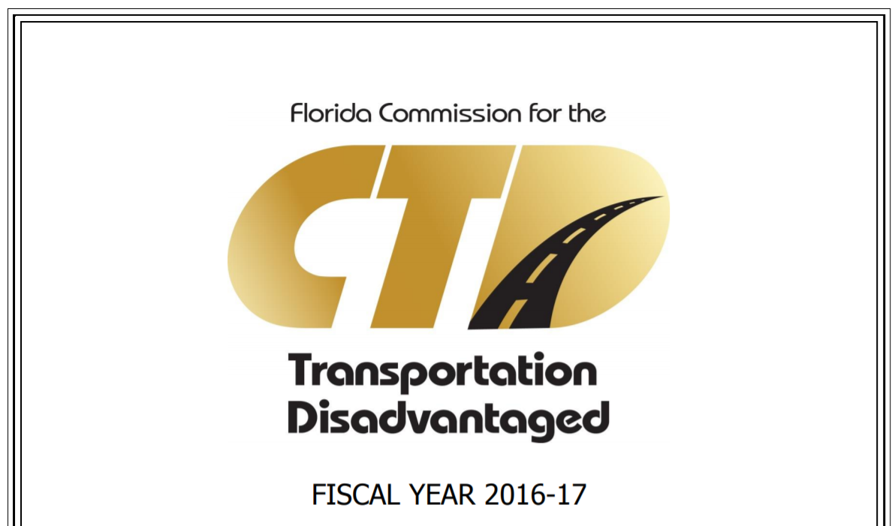
Recommendation #3 Expand and Fund a Mobility Enhancement Grant Program
Alachua County: Bus passes assist homeless persons
Bradford County: Increase the availability and responsiveness of transportation for eligible older adults, persons with disabilities and people with low incomes
Hernando County: expanded service to schedule doctor’s appointment, dialysis, treatments, etc.
Manatee County: partnering with the County’s Community Services Department and several area health care providers
Pinellas County: on-demand mobility options for eligible older adults, persons with disabilities and people of low incomes for employment or urgent, life sustaining trip purposes in situations where the 3-day advance reservation requirement cannot be met
Columbia County: provide transportation disadvantaged riders same day “on-demand” trips
Orange, Osceola, Seminole Counties: a pilot taxi voucher program
Continuation of Grant Program
CTD Administered
APD and FDDC Collaboration
$1M Committed to Persons with Disabilities Related Projects
Relevant to Other Recommendations

Slide 19
Recommendation #3 Comparison Proviso and Enhancement Grant Objectives
Minimize passenger transfer or wait times
Provide timely transportation timely as agreed upon by the user and provider;
Allow access to health care, employment, education and other life-sustaining activities;
Improve the design and use of transportation disadvantaged services in both urban and nonurban areas;
Utilize intercity and inter-county bus transportation;
Utilize regional fare payment systems or develop fare payment processes that are seamless to customers and easily utilized operationally from one mode or service operator to another; and
Utilize private providers and TNCs.
Enhance the access of older adults, persons with disabilities, and low income individuals to healthcare, shopping, education, employment, public services, and recreation;
Assist in the development, improvement, and use of transportation systems in non-urbanized areas;
Promote the efficient coordination of services;
Support inter-city bus transportation; and
Encourage private transportation provider participation

Slide 20
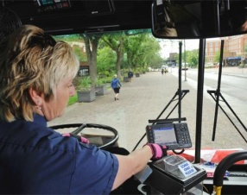
Recommendation #4 Technology Project Grant Program
Provide dispatchers with adequate time to make better dispatching decisions than the current system permits.
Speed up effective communication between dispatchers and drivers, and reduce the error rate in communicating between them.
Offer a higher level of customer service to callers requesting information or booking trips.
Accommodate the transportation needs of passengers in a more timely manner.
Generate accurate and informative reports using trip execution times and mileages.
Improve On time performance
Accurate Passenger pick up / drop off time stamp
Convenient fare technology applications

Slide 21
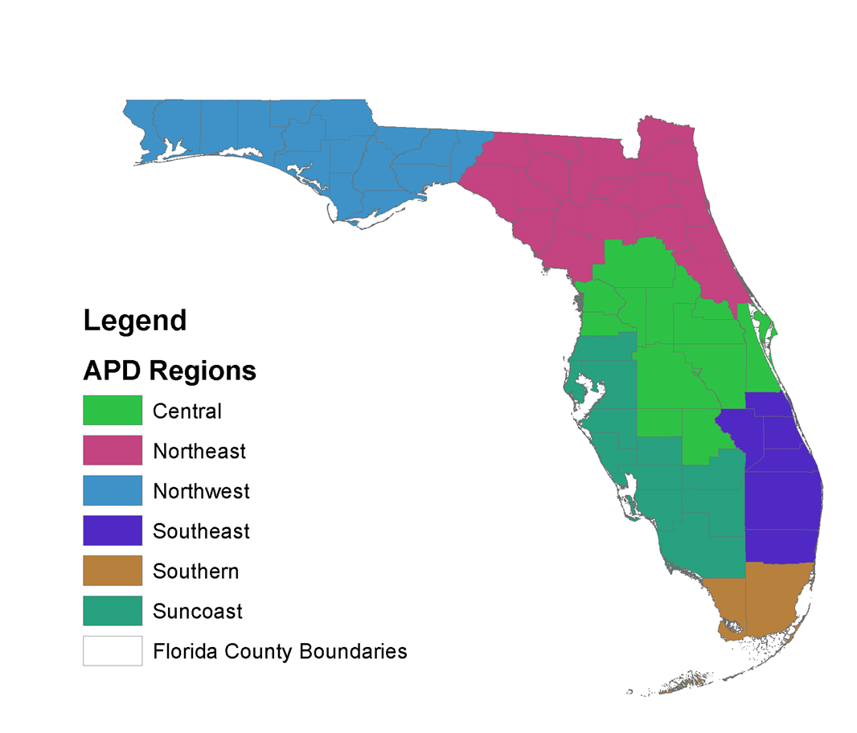
Recommendation #5 Redesign and Transition of the APD Transportation Business Model
The APD is currently operating without a centralized procedure and structure to assign APD waiver transportation services to eligible providers.
Transportation services are assigned by local waiver support coordinators who may have limited knowledge of available transportation services.
There is limited coordination with the CTCs throughout the state, due in part to the low APD trip rate reimbursements.
The lack of common definitions does not provide the ability to gather data on trip types, trips provided and costs on a statewide basis to provide a systematic assessment of the APD waiver transportation program.
There is not a consistent process to assess the quality of transportation services provided to determine if minimum contractual standards are being met in regard to vehicles, driver training and background checks, and other related factors.

Slide 22
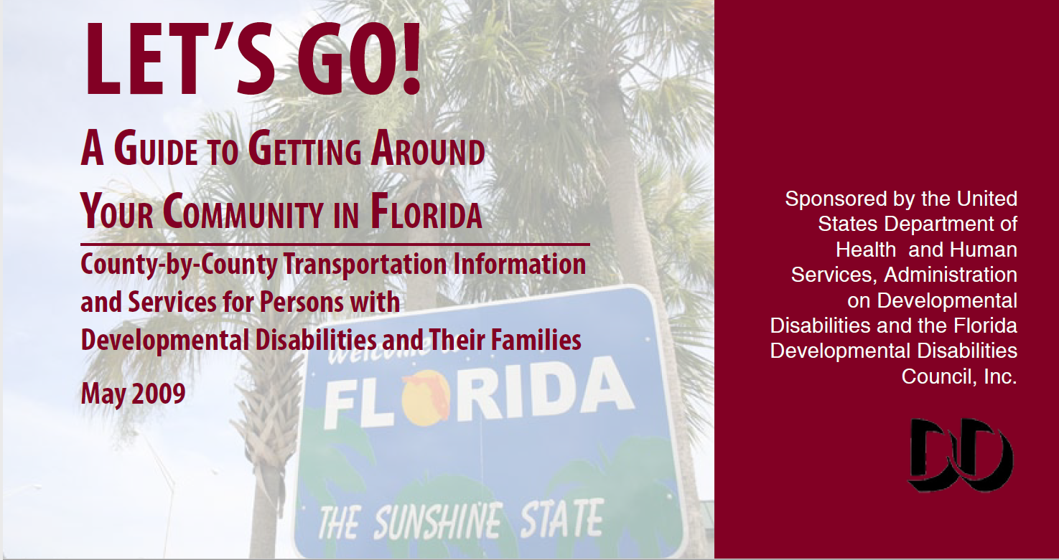
Recommendation #6 Establishment of IDD Transportation Sensitivity Training Program
Specifically Designed for Transportation Customers with Intellectual and Developmental Disabilities
Sensitivity Element Targets Transportation Personnel to Understand, Communicate and Provide Customer Care
Training Element is for Both Providers and Customers of Service to Expand Service Type Options and Capabilities

Slide 23
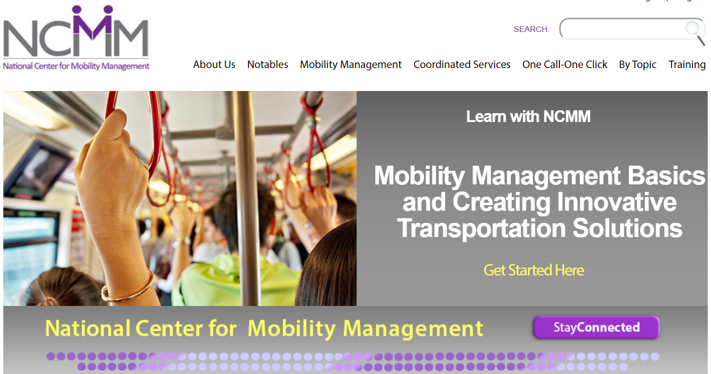
Recommendation #7 Establish a Florida Mobility Management Technical Assistance Resource Program
Technical Assistance and Professional Development Network of Mobility Mangers
Supports Education and Awareness of Techniques, Strategies and Best Practices of Mobility Management
Promotes Keen Focus on Customer Care and Advocacy
Emphasizes Specific Customer Market Needs and Tailored Transportation Options
Encourages Innovative Service Development and Partnerships
Promoted Local and Regional Coordination

Slide 24
Contact Information: Rob Gregg
gregg@cutr.usf.edu
Jay Goodwill
jaygoodwill@cutr.usf.edu
Ann Joslin
joslin@cutr.usf.edu

